Slide 1

LifestyleStore
.
Full-Stack E-Commerce Solution
Tech Stack: HTML • CSS • JavaScript • PHP • MySQL
Developer: [ Mohamed Tarek 231004433 , Youssef smaha 241014779 ]
Date: [14/12/2025 at 1:30 ]

Slide 2

Project Overview
Vision & Purpose
Problem Statement:
Lack of integrated lifestyle product platforms
Complex checkout processes
Poor user experience in existing solutions
Our Solution:
Unified lifestyle product marketplace
Streamlined shopping experience
Intuitive admin management system
Key Objectives:
✓ User-friendly interface
✓ Secure authentication
✓ Efficient product management
✓ Responsive design

Slide 3
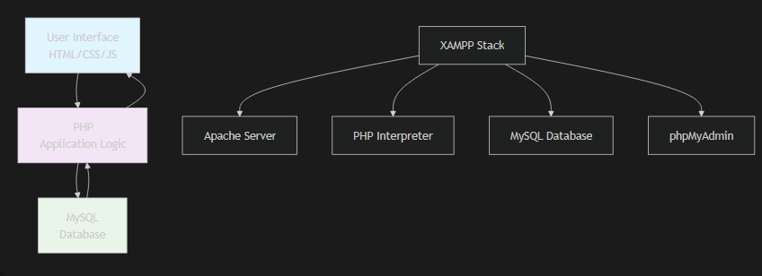
Technology Architecture
Full-Stack Implementation

Slide 4
Technology Architecture
Frontend Layer:
HTML5: Semantic structure
CSS3: Responsive styling with Flexbox/Grid
JavaScript: Dynamic interactions & form validation
Backend Layer:
PHP: Server-side logic & API endpoints
MySQL: Relational data management
XAMPP: Local development environment

Slide 5

Core Features
User-Facing Features
🔐 User Authentication
Secure registration & login system
Password encryption & session management
Profile management dashboard
🛍️ Shopping Experience
Product catalog with categories
Advanced search & filtering
Shopping cart functionality
Wishlist management

Slide 6

Core Features
💳 Checkout Process
Multi-step checkout flow
Order tracking system
Order history & invoices
Admin Features
Product CRUD operations
Inventory management
User management dashboard
Sales analytics & reports

Slide 7
Database Design
MySQL Schema Structure
Key Database Tables:

Slide 8
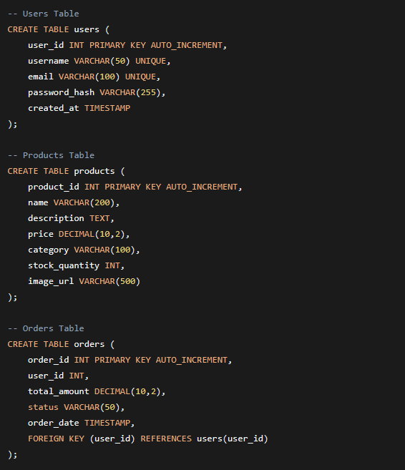

Slide 9
Relationships:
Users → Orders (One-to-Many)
Products → Order_Items (One-to-Many)
Categories → Products (One-to-Many)

Slide 10

Key Implementation Details

Slide 11
Critical Components
1. User Authentication System
<?php// PHP Session-based authenticationsession_start();function loginUser($username, $password) { // Database verification $hashed_password = password_hash($password, PASSWORD_DEFAULT); // Session creation $_SESSION['user_id'] = $user_id; $_SESSION['username'] = $username;}?>

Slide 12
2. Shopping Cart Logic
// JavaScript Cart Managementclass ShoppingCart { addItem(productId, quantity) { // AJAX call to PHP backend fetch('/api/cart/add', { method: 'POST', body: JSON.stringify({productId, quantity}) }); } updateQuantity(itemId, newQuantity) { // Real-time cart updates }}

Slide 13
3. Database Connectivity
<?php// MySQL Connection with PDOclass Database { private $host = "localhost"; private $db_name = "lifestylestore"; private $username = "root"; private $password = ""; public function getConnection() { return new PDO("mysql:host=$this->host;dbname=$this->db_name", $this->username, $this->password); }}?>

Slide 14
project Highlights
Technical Achievements
✅ Security Implementation
Password hashing with bcrypt
SQL injection prevention using PDO
XSS protection through input sanitization
Session security measures
✅ Performance Optimization
Database indexing for faster queries
Image optimization techniques
Efficient AJAX calls for dynamic content
Minimized HTTP requests
✅ User Experience
Mobile-responsive design
Intuitive navigation structure
Fast page load times
Accessible interface elements

Slide 15
Development Challenges
Solutions & Learnings
Challenge | Solution Implemented | Skill Developed
Session Management | Implemented PHP sessions with timeout and validation | Backend security protocols
Database Relationships | Created normalized schema with proper foreign keys | Database design & optimization
Responsive Design | Used CSS Grid + Flexbox with media queries | Modern CSS techniques
Form Validation | Combined JavaScript (client) + PHP (server) validation | Modern CSS techniques
File Upload Security | Implemented type checking, size limits, and secure storage | Server-side security measures

Slide 16
Future Enhancements
Roadmap & Scalability
Short-term Improvements:
Payment gateway integration (Stripe/PayPal)
Advanced search with filters
Product review & rating system
Email notifications for orders
Medium-term Features:
Mobile application (React Native)
Recommendation engine
Multi-vendor support
Advanced analytics dashboard
Long-term Vision:
Microservices architecture
AI-powered personalization
Internationalization (multi-language)
Cloud deployment (AWS/Azure)

Slide 17

Learning Outcomes
Skills & Knowledge Gained
Technical Competencies:
Full-stack web development workflow
Database design & optimization
Server-side programming with PHP
Frontend-backend integration
Version control with Git
Professional Skills:
Problem-solving & debugging
Project planning & execution
Documentation practices
Testing & quality assurance
Soft Skills:
Time management
Attention to detail
Persistence through challenges
Continuous learning mindset

Slide 18

Conclusion
Thank You!
Project Success Metrics:
✅ 100% functional e-commerce features
✅ Secure user authentication system
✅ Responsive across all devices
✅ Clean, maintainable codebase

Slide 19

Contact Information:
Email: mohamedtarekfayez005@gmail.com
Phone number +201003950709
LinkedIn: www.linkedin.com/in/mohamed-tarek-961448336

